Slide 1
Concurrency
Database Systems Lecture 15
Natasha Alechina

Slide 2
In This Lecture
Concurrency control
Serialisability
  Schedules of transactions
  Serial & serialisable schedules
Locks
2 Phase Locking protocol (2PL)
For more information
  Connolly and Begg chapter 20
  Ullman and Widom chapter 8.6

Slide 3
Need for concurrency control
Previous lecture: transactions running concurrently may interfere with each other, causing various problems (lost updates etc.)
Concurrency control: the process of managing simultaneous operations on the database without having them interfere with each other.

Slide 4
Lost Update
T1 T2
Read(X)
X = X - 5
Read(X)
X = X + 5
Write(X)
Write(X)
COMMIT
COMMIT
This update
Is lost
Only this update
succeeds

Slide 5
Uncommitted Update
(“dirty read”)
T1 T2
Read(X)
X = X - 5
Write(X)
Read(X)
X = X + 5
Write(X)
ROLLBACK
COMMIT
This reads the value of X which it should not have seen

Slide 6
Inconsistent analysis
T1 T2
Read(X)
X = X - 5
Write(X)
Read(X)
Read(Y)
Sum = X+Y
Read(Y)
Y = Y + 5
Write(Y)
Summing up
data while it is
being updated

Slide 7
Schedules
A schedule is a sequence of the operations by a set of concurrent transactions that preserves the order of operations in each of the individual transactions
A serial schedule is a schedule where operations of each transaction are executed consecutively without any interleaved operations from other transactions (each transaction commits before the next one is allowed to begin)

Slide 8
Serial schedules
Serial schedules are guaranteed to avoid interference and keep the database consistent
However databases need concurrent access which means interleaving operations from different transactions

Slide 9
Serialisability
Two schedules are equivalent if they always have the same effect.
A schedule is serialisable if it is equivalent to some serial schedule.
For example:
  if two transactions only read some data items, then the order is which they do it is not important
  If T1 reads and updates X and T2 reads and updates a different data item Y, then again they can be scheduled in any order.

Slide 10
Serial and Serialisable
Interleaved Schedule
T1 Read(X)
T2 Read(X)
T2 Read(Y)
T1 Read(Z)
T1 Read(Y)
T2 Read(Z)
This schedule is serialisable:
Serial Schedule
T2 Read(X)
T2 Read(Y)
T2 Read(Z)
T1 Read(X)
T1 Read(Z)
T1 Read(Y)

Slide 11
Conflict Serialisable Schedule
Interleaved Schedule
T1 Read(X)
T1 Write(X)
T2 Read(X)
T2 Write(X)
T1 Read(Y)
T1 Write(Y)
T2 Read(Y)
T2 Write(Y)
This schedule is serialisable,
even though T1 and T2 read
and write the same resources
X and Y: they have a conflict
Serial Schedule
T1 Read(X)
T1 Write(X)
T1 Read(Y)
T1 Write(Y)
T2 Read(X)
T2 Write(X)
T2 Read(Y)
T2 Write(Y)

Slide 12
Conflict Serialisability
Two transactions have a conflict:
  NO If they refer to different resources
  NO If they are reads
  YES If at least one is a write and they use the same resource
A schedule is conflict serialisable if transactions in the schedule have a conflict but the schedule is still serialisable

Slide 13
Conflict Serialisability
Conflict serialisable schedules are the main focus of concurrency control
They allow for interleaving and at the same time they are guaranteed to behave as a serial schedule
Important questions: how to determine whether a schedule is conflict serialisable
How to construct conflict serialisable schedules

Slide 14
Precedence Graphs
To determine if a schedule is conflict serialisable we use a precedence graph
  Transactions are vertices of the graph
  There is an edge from T1 to T2 if T1 must happen before T2 in any equivalent serial schedule
Edge T1 → T2 if in the schedule we have:
  T1 Read(R) followed by T2 Write(R) for the same resource R
  T1 Write(R) followed by T2 Read(R)
  T1 Write(R) followed by T2 Write(R)
The schedule is serialisable if there are no cycles

Slide 15
Precedence Graph Example
The lost update schedule has the precedence graph:
T1 T2
Read(X)
X = X - 5
Read(X)
X = X + 5
Write(X)
Write(X)
COMMIT
COMMIT
T1 Write(X) followed by T2 Write(X)
T1
T2
T2 Read(X) followed by T1 Write(X)

Slide 16
Precedence Graph Example
No cycles: conflict serialisable schedule
T1 T2
Read(X)
Write(X)
Read(X)
Write(X)
T1 reads X before T2 writes X and T1 writes X before T2 reads X and T1 writes X before T2 writes X
T1
T2

Slide 17
Locking
Locking is a procedure used to control concurrent access to data (to ensure serialisability of concurrent transactions)
In order to use a ‘resource’ (table, row, etc) a transaction must first acquire a lock on that resource
This may deny access to other transactions to prevent incorrect results

Slide 18
Two types of locks
Two types of lock
  Shared lock (S-lock or read-lock)
  Exclusive lock (X-lock or write-lock)
Read lock allows several transactions simultaneously to read a resource (but no transactions can change it at the same time)
Write lock allows one transaction exclusive access to write to a resource. No other transaction can read this resource at the same time.
The lock manager in the DBMS assigns locks and records them in the data dictionary

Slide 19
Locking
Before reading from a resource a transaction must acquire a read-lock
Before writing to a resource a transaction must acquire a write-lock
Locks are released on commit/rollback
A transaction may not acquire a lock on any resource that is write-locked by another transaction
A transaction may not acquire a write-lock on a resource that is locked by another transaction
If the requested lock is not available, transaction waits

Slide 20
Two-Phase Locking
A transaction follows the two-phase locking protocol (2PL) if all locking operations precede the first unlock operation in the transaction
Two phases
  Growing phase where locks are acquired on resources
  Shrinking phase where locks are released

Slide 21
Example
T1 follows 2PL protocol
  All of its locks are acquired before it releases any of them
T2 does not
  It releases its lock on X and then goes on to later acquire a lock on Y
T1 T2
read-lock(X) read-lock(X)
Read(X) Read(X)
write-lock(Y) unlock(X)
unlock(X) write-lock(Y)
Read(Y) Read(Y)
Y = Y + X Y = Y + X
Write(Y) Write(Y)
unlock(Y) unlock(Y)

Slide 22
Serialisability Theorem
Any schedule of two-phased transactions is conflict serialisable

Slide 23
Lost Update can’t happen with 2PL
T1 T2
Read(X)
X = X - 5
Read(X)
X = X + 5
Write(X)
Write(X)
COMMIT
COMMIT
read-lock(X)
read-lock(X)
cannot acquire
write-lock(X):
T2 has read-lock(X)
cannot acquire
write-lock(X):
T1 has
read-lock(X)

Slide 24
Uncommitted Update cannot happen with 2PL
T1 T2
Read(X)
X = X - 5
Write(X)
Read(X)
X = X + 5
Write(X)
ROLLBACK
COMMIT
read-lock(X)
write-lock(X)
Waits till T1
releases
write-lock(X)
Locks released

Slide 25
Inconsistent analysis cannot happen with 2PL
T1 T2
Read(X)
X = X - 5
Write(X)
Read(X)
Read(Y)
Sum = X+Y
Read(Y)
Y = Y + 5
Write(Y)
read-lock(X)
write-lock(X)
Waits till T1
releases
write-locks on
X and Y
read-lock(Y)
write-lock(Y)

Slide 26
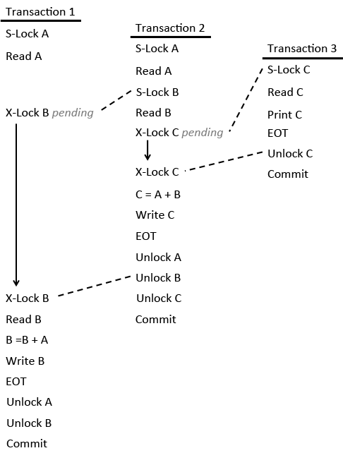
2pl example

Slide 27
Next Lecture
Deadlocks
  Deadlock detection
  Deadlock prevention
Timestamping
For more information
  Connolly and Begg chapter 20
  Ullman and Widom chapter 8.6

